Slide 1
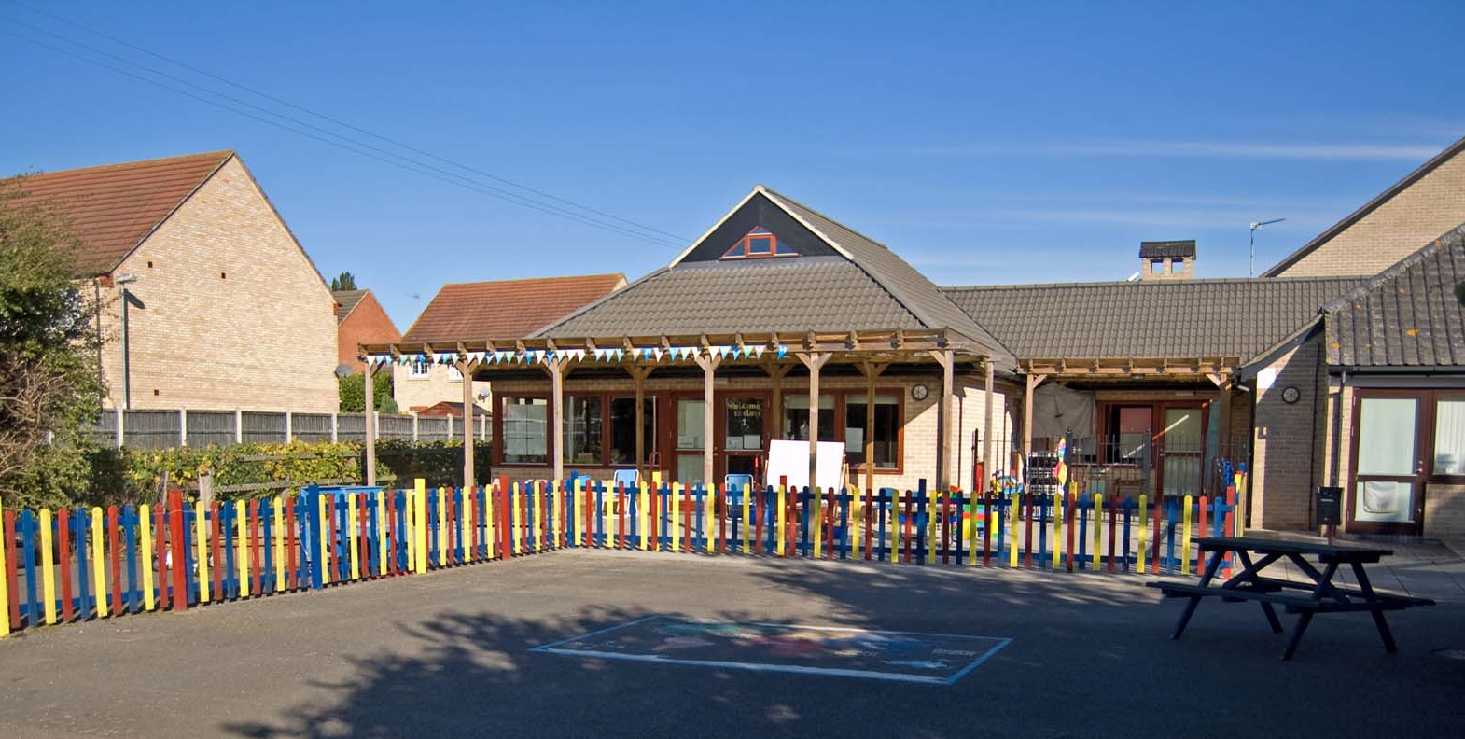
Welcome to Ashbeach School

Slide 2
The Early Years
Foundation Stage
The EYFS framework consists of 17 Early Learning Goals, which your child has been working towards through their pre-school experiences.
These areas are primarily taught through play and fun activities, with an increase in more formal teaching as the year progresses.
We want to encourage children to become fully engrossed in their learning whether it be self initiated or adult led. This can be achieved in many ways including investigating, problem solving, exploring, be active, being hands on and working with others.
With this comes times where the children will get messy- maybe in mud, paint or sand etc.
We believe the messier they get the more fun they have and the more engrossed in their learning they are!
Notes:
EYFS- 17 ELG and 7 areas of learning
Play is essential part of learning in the Early years and this can be child initiated, adult directed or adult led.
There will be opportunities for your child to choose their learning by accessing the learning environment through the continuous provision and activities that are set up. There will also be times where an adult may direct a child to an activity to ensure they are practising a particular skill and there will be times when chdirlen are expected to work with an adult.

Slide 3
Areas of learning:
Prime areas:
Communication and language;
Physical development; and
Personal, social and emotional
development.
Specific areas:
Literacy;
Mathematics;
Understanding the world; and
Expressive arts and design.
Notes:
The prime areas are the areas are the three areas that are particularly crucial for igniting children’s curiosity and enthusiasm for learning, and for building their capacity to learn, form relationships and thrive i.e. a confident child who can communicate their and be confident in making big and small movements with their bodies i.e. handwriting- small fine motor muscle movements
The specific areas are taught alongside the prime areas and allow the skills from the 3 prime areas to be strengthened and applied

Slide 4
Characteristics of Learning
Playing and exploring - children investigate and experience things, and ‘have a go’;
Active learning - children concentrate and keep on trying if they encounter difficulties, and enjoy achievements; and
Creating and thinking critically - children have and develop their own ideas, make links between ideas, and develop strategies for doing things.
Notes:
How children learn not just what they learn!

Slide 5
Starting School
Before September:
Children are invited into school for the afternoon to spend time in their classroom with some of the adults they will see in September.
You can request a home visit.
The class teacher will make contact with your child's nursery setting.
Notes:
We have introduced home visits as an important part of our transition into school because it gives us an opportunity to visit the child in a setting that is theirs where they feel comfortable and confident as apposed to always coming into our setting. It a good conversation starter in September and children tend to like having the responsibility of showing their etcaher some of their favourite toys or their pets etc. please fill in a home visit sheet before you leave

Slide 6
September…
Term starts Monday 4th September 2023. Children will do part time sessions until Week beginning 18th September 2023.
Please refer to your letter for group a and b dates and times.
From the 18th September we will offer full time sessions if we feel your child is ready (8:40am- 3:15pm)
Notes:
School starts at 8:40am and finishes at 3:15pm
New lunch timings

Slide 7
What will your
child need?
The correct school uniform
PE kit – blue shorts, a blue t-shirt for indoor activities. In the spring/summer term the children will need jogging bottoms, sweatshirt and trainers for outdoor games
A pair of Wellington boots (these stay at school each day)
A school book bag
A school water bottle
All uniform can now be purchased from Chroma Sport.
Please label everything!!!
Notes:
We will be trialling no indoor shoes as the children are always in and out of the classroom and it does take a long time for them to change their shoes- we emphasis having a pair of wellies at school for wet weather and a sturdy pair of black school shoes for everything else

Slide 8
Lunch times
Since September 2014 all children in Foundation stage and Key Stage 1 have been offered a free school meal every day.
Our school Cook is here tonight to give a sample of the kind of food served at lunch times.
If your child would prefer pack lunches we have some packed lunch guidance to ensure packed lunches are balanced and healthy.
Notes:
Intro sheet in pack

Slide 9
A day in the life of a Penguin child…
‘I get to school and register my name’
‘I find my mini me’
‘We do phonics everyday and counting everyday’
‘We play- we do busy learning’
‘We have lunch in the hall’
‘We have playtime on the playground in the morning and after lunch’
‘We sometimes have a story on the carpet.’
‘We get our things ready for home time’

Slide 10
Forest schools/Outdoor learning
Forest school is an approach to education that was developed in Scandinavia in the 1950s and was introduced to the UK in the 1990s. Studies have shown Forest School to have an impact on children’s confidence, self-esteem and all areas of learning and development.
We go out in all weathers so your
child will need to be dressed appropriately for that day. Wellies are a necessity!

Slide 11
What we have seen from our
Forest School/Outdoor sessions:
New friendships
Imaginative games- mainly superheroes!
Developing communication skills
Confident active children
Children pushing their limits
-tree climbing
Developing knowledge of
their environment and how
it changes.
Children working together and negotiating
-den building

Slide 12
How can you help prepare
your child for school?
Talk- talk about school, what they are looking forward to, what they are worried about.
Develop independence- it may take longer but giving children the opportunities to do things for themselves will develop their confidence.

