Slide 1
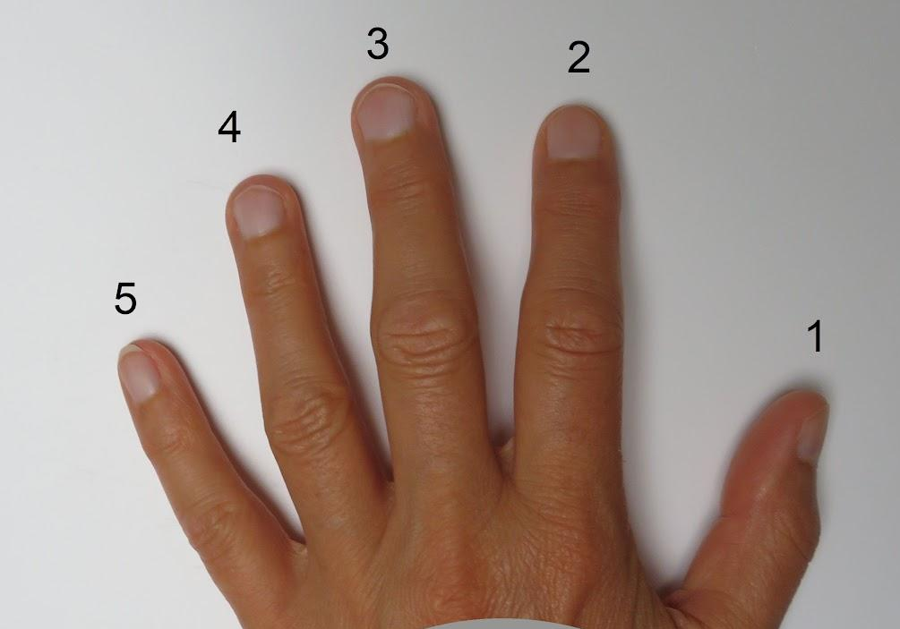
5 finger rule
2 or 3
This is just right. It will have a challenge but you can read it.
4 or 5
This will be too difficult for you to read it and enjoy it.
0 - 1
This should be easy to read.

Slide 2
Five Finger Rule!
Here’s how it works: Your child opens a book to the first page. They read the page and hold up one finger for every word they don’t know or can’t pronounce. The number of fingers they’re holding up by the end of the page tells them if the book is the right level:
0-1 fingers: It’s easy.
2-3 fingers: It’s just right.
4-5 fingers: It’s too hard (or best read aloud with a buddy).
Two to three fingers is the sweet spot. If they’re holding up any more or less, that’s a clue that they should try to find another book if they’re reading independently.

